Slide 1
REALIZATION OF PHYSICAL ENVIRONMENT WITH DIGITAL TWIN AND ANALYSIS
G VS Bhargav -18BEC013
G Sai Harsha - 18BEC016
K Bharath - 18BEC023
P Sathvik - 18BEC038

Slide 2
CONTENT
Introduction
Definition
Advantages
How to make a digital twin ?
Azure Digital twin platform
Our physical system

Slide 3
INTRODUCTION
The concept of digital twin was first used and applied by Michael Grieves in 2002.
Grieves proposed the digital twin as the conceptual model underlying product lifecycle management (PLM).
Later on this concept was adopted and used by NASA in their projects.
It is the most trending technology in recent years as many of the Industries,Complex designs are created using this technology through which we can expose our system to the harsh environment and get feedback from digital twin which saves us lot of money and hard labour of construction.
Let’s know more about “THE DIGITAL TWIN”....!

Slide 4

Definition
Digital twin is the ability to take a virtual representation of elements and the dynamics of how an internet of things device operates and works.
It's more than a blue print it's more than a schematic it's not just a picture it's a lot more than how it looks and sounds it's virtual representation of both elements and dynamics of how IOT device operates and lives through its lifecycle.
-Chris O’Connor(IBM)

Slide 5
It's understanding of all of its dynamics whether it's electrons that moves or whether it's the device that's moving itself, it's about understanding the elements that compose it and dynamics of how device is put together.
If it's done correctly digital twin will influence how design build and operations of a device are constructed in single life cycle.

Slide 6

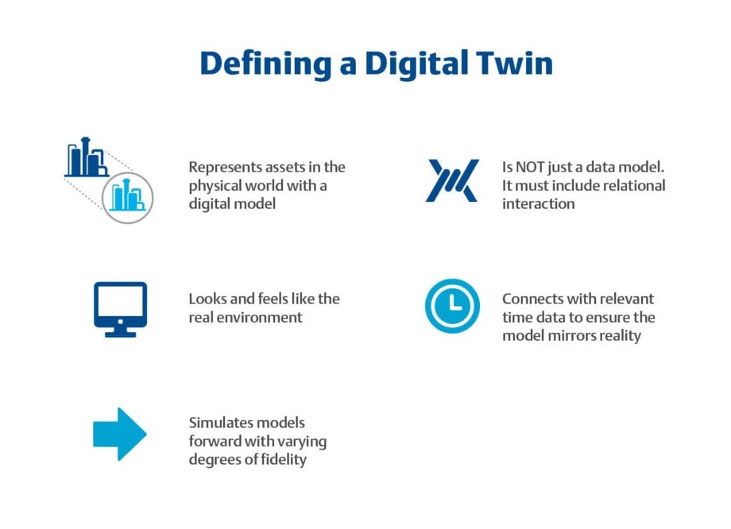
The digital twin concept consists of three distinct parts: the physical product, the digital/virtual product, and connections between the two products.
The connection between digital and physical product is bi-directional data from physical system to virtual model and vice-versa.
A physical system can have multiple virtual twin depending on user usage

Slide 7

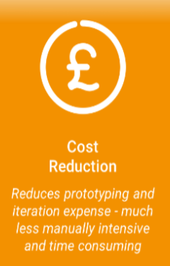
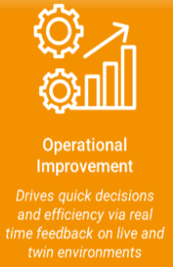
ADVANTAGES OF DIGITAL TWIN

Slide 8
HOW TO MAKE A DIGITAL TWIN
Digital twin has 5 phases of making
ANALYSIS PHASE:
This is the most important phase because it will define all processes, data and the use of the digital twin.We establish designs of the process that allow us to visually realise your process within the digital twin of the organisation.
PROGRAMING PHASE:
In Digital twin platform we establish our virtual environment using programing language
BUILD PHASE:
In this phase we make physical machine

Slide 9
4. CONNECTION PHASE:
We establish connection between virtual machine and physical machine
using Different data transfer techniques
5. ACTIVATION PHASE:
We activate which is go-live phase to test the system in different areas like
speed, response time, cloud service etc..

Slide 10
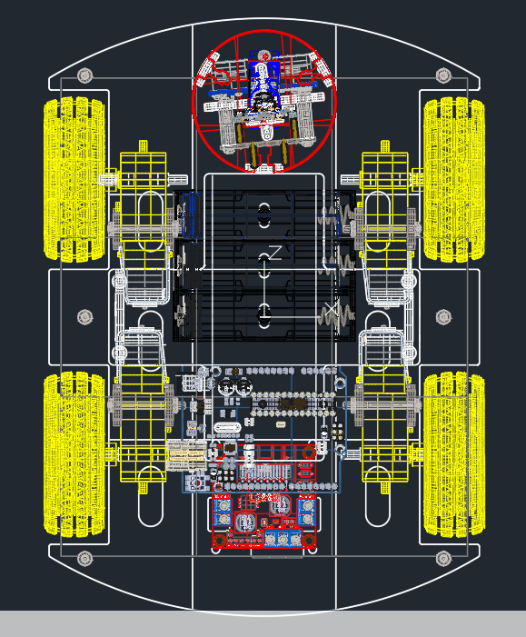
3D virtual representation of Physical system
For this we have created our ‘SCOUT’ Digitally through CAD Platform
CAD is Computer Aided Design which is a way of representing system or things through 2D drawing on CAD application which gives base plan for how the real product should be made.

Slide 11
3D representation is something which is really helpful and handy to understand how the product looks like after finished.
A software kit ‘HOOPS web platform’ perfectly complement ADT by importing CAD file which was created and display it in web page.
Using HOOPS and ADT we can create any system in the world with attractive and user friendly interface.
When ADT nodes are associated with 3D data such as Buildings,Bridges,Machinery we can view in HWV so that the owner could get keen sense on it that structure.
HWV(Hoops web viewer) is browsing page we get into when we import our CAD file and convert and run it in server.
While creating our 3D model of physical system, we converted CAD file to stream cache standalone(SCS) file by using Hoops converter.

Slide 12
Stream Cache Standalone (SCS) - These singular files can be easily loaded with REST API functions, just as you would some other file. The entire file must be downloaded before visualizing.
After that we deployed ‘SCOUT’ into AZURE APP service.
Now we will run the server and show you how the 3D model looks.
LET’S GET STARTED…..!
Virtual 3D-Model link:
https://finalproject2022.z30.web.core.windows.net/hoops_web_viewer_sample.html?scs=scs_models/scout.scs

Slide 13
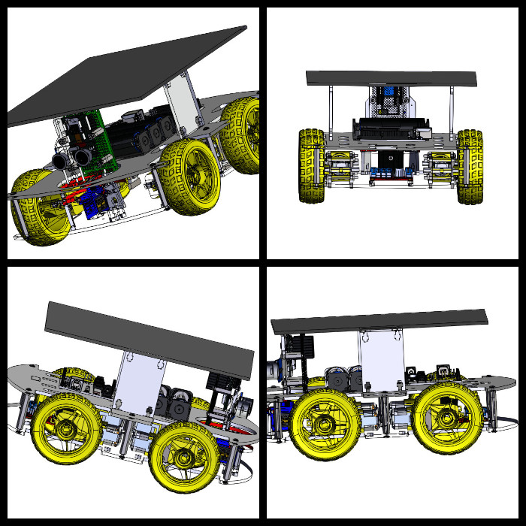

Slide 14
Future works going on in Hoops :
Hoops developers are taking more initiative to make 3D model more interactive
And developer friendly which needs integration between HOOPS and ADT .
Authoring Tool 3D model data already exist in ADT graph, with sample code accompanying UI they are making it to authoring, editing of this data on the 3D screen and then save to ADT graph.
SignalR quarrying ADT graph using API on five second timer which gives us Real time data on the 3D model.
Object Instancing every Instance in 3D object in ADT is loaded on to the
3D scene.

Slide 15
Softwares For Digital Twin Implementation
Azure Digital Twin
Mosquitto Ditto
AWS

Slide 16
Azure Digital Twin

Slide 17
Procedure to Create an Azure digital twin
Create Azure Digital Twin Instance
Create an Azure IOT hub.
Create Azure Function App to manage data flow between client and digital twin instance.

Slide 18
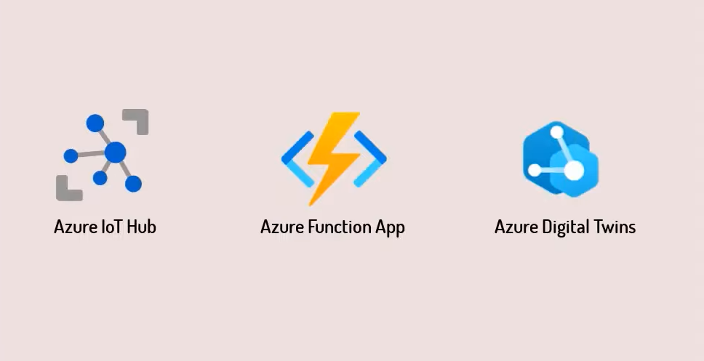

Slide 19
Before creating the Digital Twin Instance we should create a Digital Twin Model using DTDL language.
The Digital Twins Definition Language (DTDL) is a language for describing models and interfaces for IoT digital twins. It is based on the open source language JSON-DL.
A general Digital twin model consists of-
Properties- The variables with this type require a storage system to retain permanently and they can be updated when necessary. It can be used for name, serial no, color etc.
Telemetry- It is mostly used for sensor data. It is not stored in the digital twin, instead it is used to do operations like machine learning the twin.
Components- It is used to define separate models which are part of a model.
Relationships- It is used to tell how one digital twin is related to another.
The written code is saved as a .json folder.

Slide 20
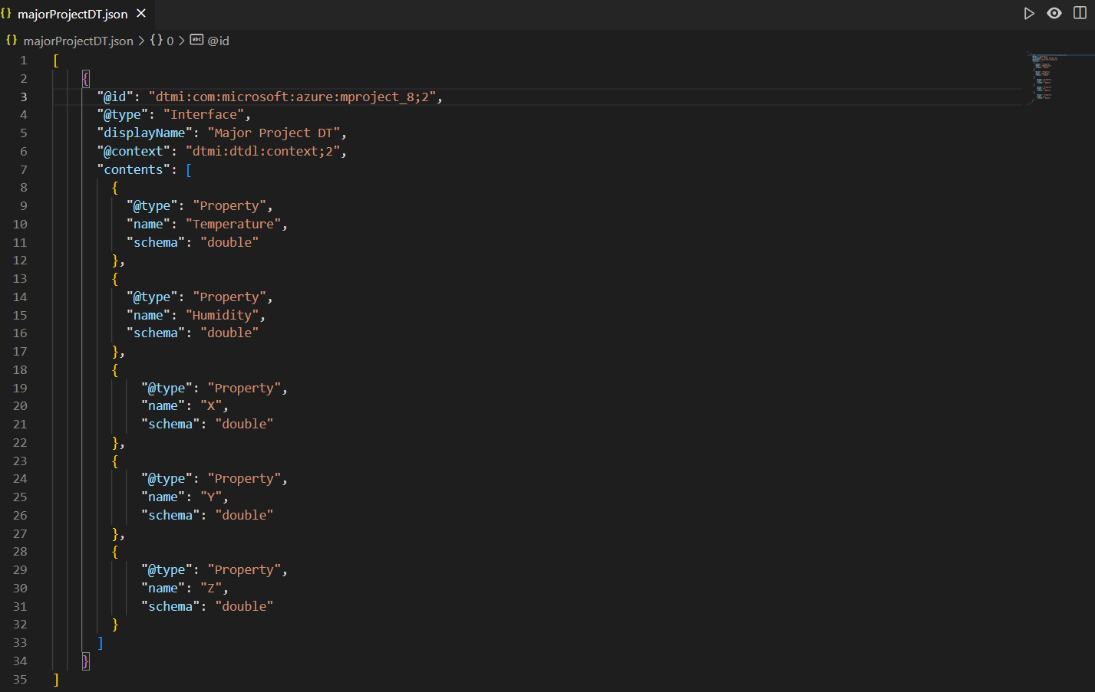
DTDL Code

Slide 21
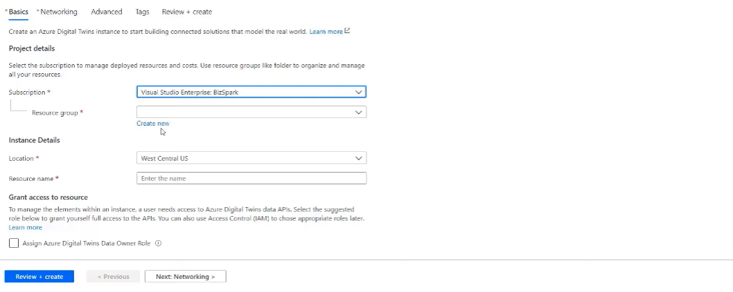
Creating a Digital Twin Instance
To create a digital twin instance in Azure we go to create a resource, then search Azure Digital Twin and and click on create. Then we select our subscription, location, create a new resource group, and write the resource name and then review + create.
The host name, resource group and instance name should be noted.

Slide 22
After deployment we assign “Azure Digital Twin Data Owner” role to the Microsoft / Azure account which we use to login into our IDE. We do this by add role assignments in Access Control tab.
To access the data from the Assure digital twin instance we can either use Azure Digital Twin Explorer or any client app. Using Azure Digital Twin Explorer we can upload models, retrieve data, change data and a lot more.
To work on Azure Digital Twin Explorer we first need to login to the account which has the ownership role through our IDE. When we open the Azure Digital Twin Explorer it asks to give the URL of the digital twin which is the “https://host name of the Instance”.

Slide 23
The next step is to upload the digital twin model .json file into the Azure Digital Twin Explorer and then create a new digital twin with a unique name.
When we do this a new node is created in the graph view. Clicking on this node shows the properties of the node(digital twin). Also if the model has any components or relations they can also be visible by an arrow pointing to the next node.

Slide 24
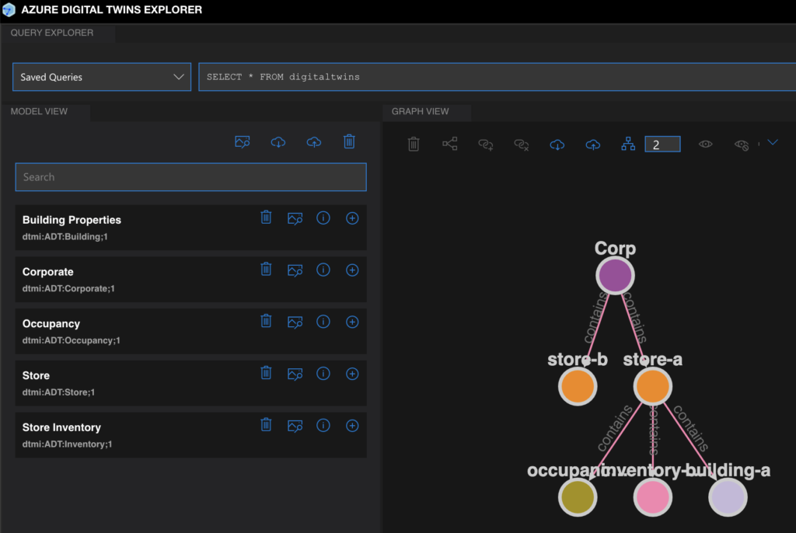
Digital Twin Graph Example

Slide 25
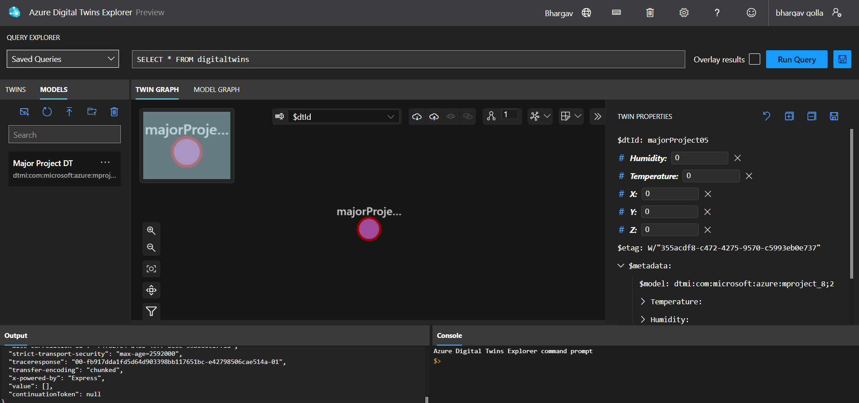
Digital Twin Graph

Slide 26
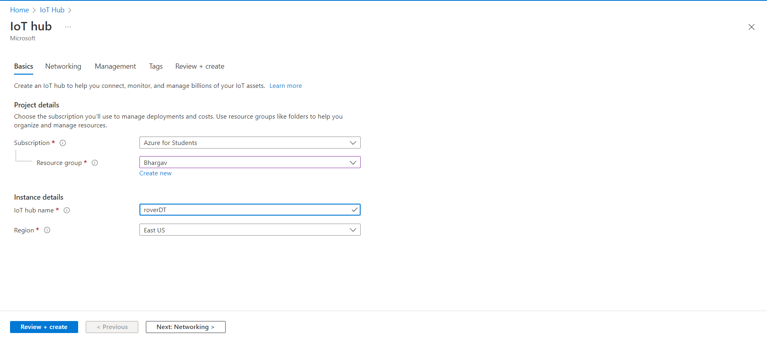
2. Creating an Azure IoT Hub
Same like Azure Digital Twin instance we search for Azure IoT Hub and create a new IoT Hub. The resource group must be the same resource group as the Azure Digital Twin instance.

Slide 27
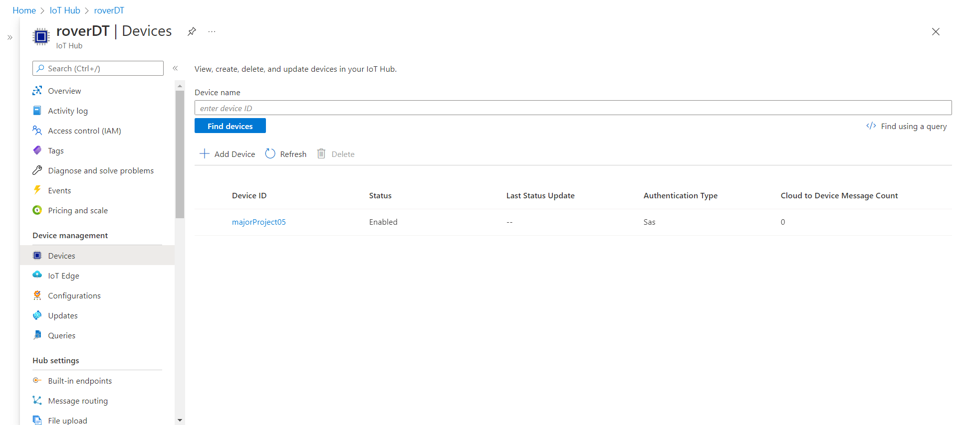
After Deployment of the IOT Hub a new IoT device is created with same name as Digital Twin in the Explorer. Now that the IoT Device is created the next step is to create a new Function App.

Slide 28
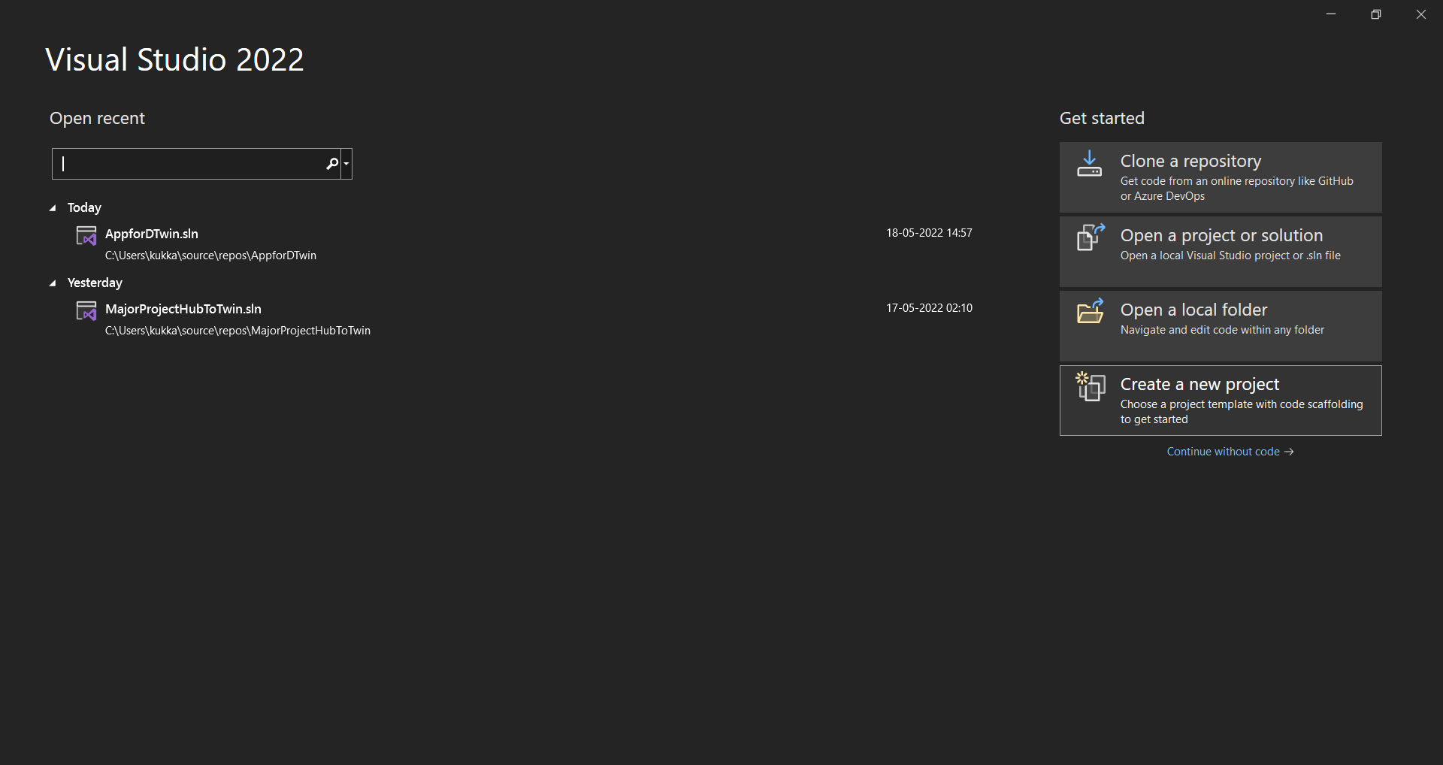
3. Creating an Azure Function App
A new Azure Function App is created using Visual Studio and event grid trigger is selected as a template. The necessary extensions are installed using NuGet packages.

Slide 29
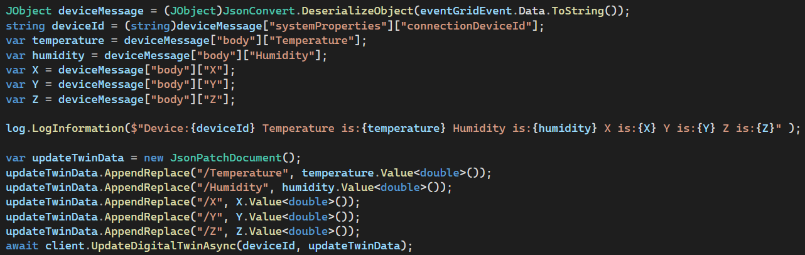
The function should send and receive messages by deserializing the messages from event grid, separate the required properties and then serialize the message in .json format which is sent to the Digital Twin Instance.The App is then published with a unique name.

Slide 30
Then permissions and role assignments are given to the function app from the IoT Hub and Digital Twin Instance by informing that they all belong to the same resource group. An event subscription is done for IoT Hub to Event Grid with The Function App as an end point.
The Telemetry messages are sent to the Function App through the event grid. Then the Function App updates the Azure Digital Twin Explorer. This is how the IoT Hub and Digital twin Instance communicates with each other.
This the basic setup of the Digital Twin in a virtual platform. The next step is building of physical system.

Slide 31
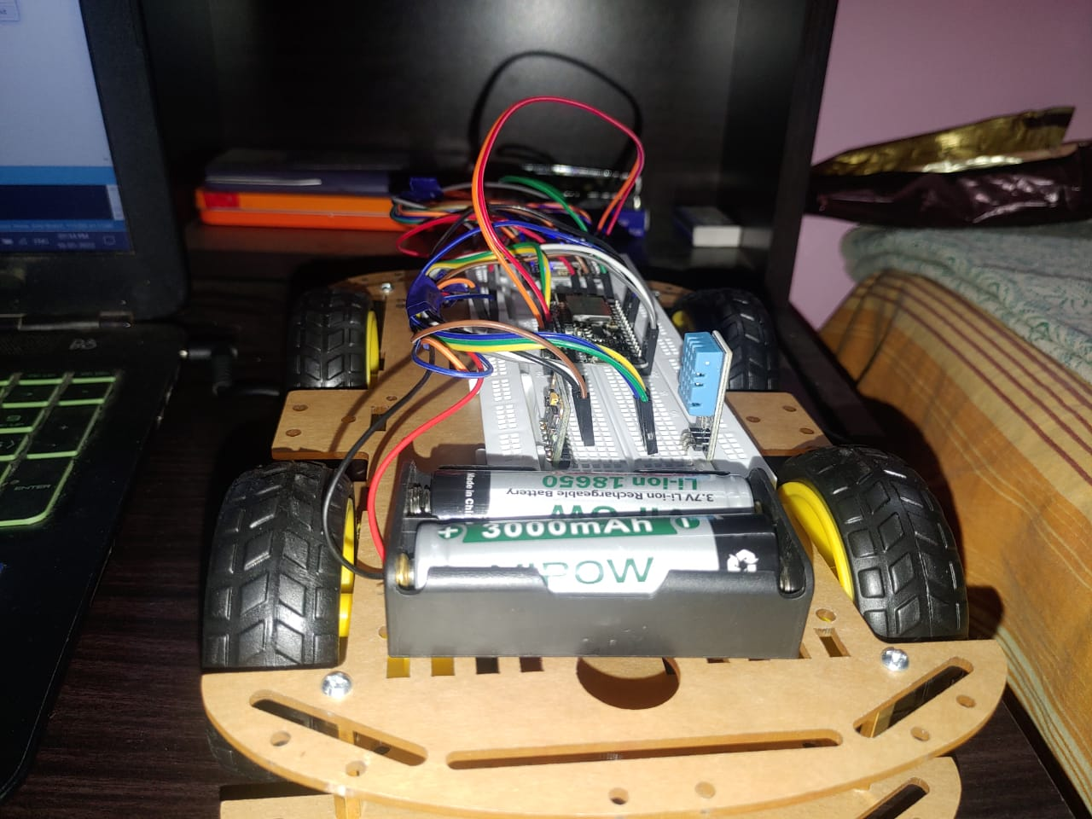
OUR Physical system
Our Physical system is a robot controlled Car we call is “SCOUT”
As name says it monitors and finds about thing
It’s Functionalities are
Sensing the environment
Wifi controlled
Cloud connected
It’s just a simple system that we are building, our main goal is to realize this physical system through digital twin.
Its true that digital twin was made for large systems like aircrafts,bridges, factories but this projects will be as first step in learning and building the large projects.

Slide 32
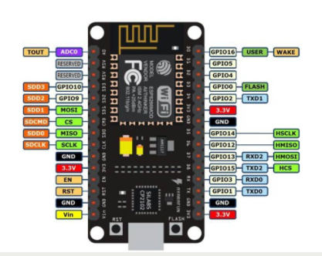
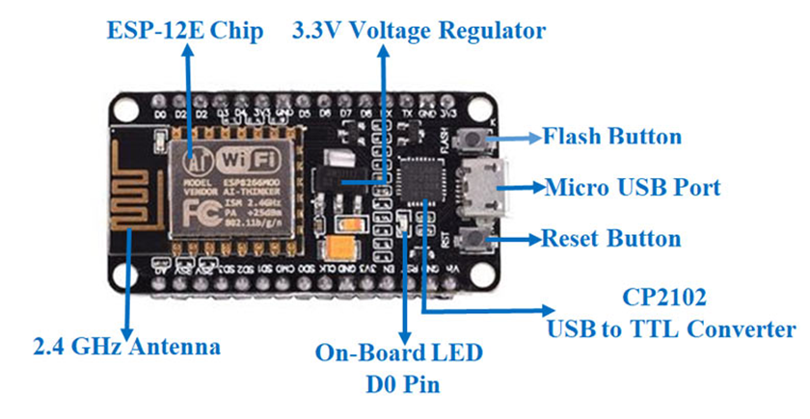
HARDWARE
NOdeMCU ESP8266
NodeMCU is an open-source development board,targeted for IoT based Applications. It includes firmware that runs on the ESP8266 Wi-Fi SoC from Espressif Systems, and hardware which is based on the ESP-12 module. Microcontroller can be powered by using a Micro Vin pin and USB jack. This supports UART, SPI, and I2C interface.

Slide 33
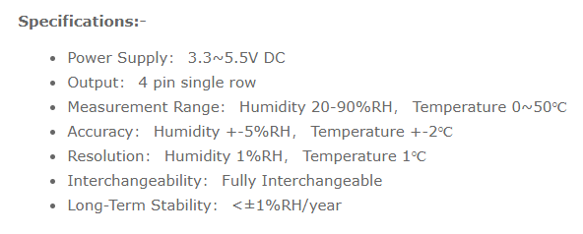
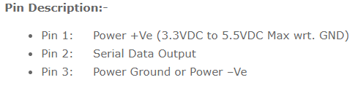
Specifications & features:
Microcontroller Tensilica 32-bit RISC Xtensa CPU, Operating Voltage(3.3V), Input Voltage(7-12V), 16 Digital I/O Pins (DIO), 1 Analog Input Pins (ADC), UART, Flash Memory (4 MB), SRAM(64 KB), Clock Speed(80-160 MHz), USB-TTL, PCB Antenna, Small Sized module that can fit perfectly for iot applications.
2. DHT11 Humidity and Temperature Sensor
DHT11 is a Humidity and Temperature Sensor, which generates calibrated digital output. DHT11
can be interface with any microcontroller.DHT11 is a low cost humidity and temperature sensor which provides high reliability and long term stability.It uses a capacitive humidity sensor and a thermistor to measure the surrounding air, and outputs a digital signal on the data pin.It has high reliability and excellent long-term stability, thanks to the exclusive digital signal acquisition technique and temperature & humidity sensing technology.

Slide 34
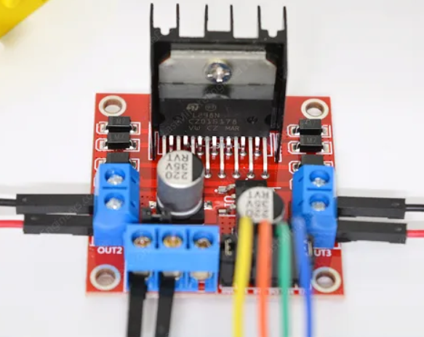
L298N Motor Driver
In order to have a complete control over DC motor, we have to control its speed and rotation direction. This can be achieved by combining these two techniques.
PWM – For controlling speed The speed of a DC motor can be controlled by varying its input voltage. A common technique for doing this is to use PWM (Pulse Width Modulation).PWM is a technique where average value of the input voltage is adjusted by sending a series of ON-OFF pulses.
H-Bridge – For controlling rotation direction The DC motor spinning direction can be controlled by changing polarity of its input voltage. A common technique for doing this is to use an H-Bridge.An H-Bridge circuit contains four switches with the motor at the center forming an H-like arrangement. Closing two particular switches at the same time reverses the polarity of the voltage applied to the motor. This causes change in spinning direction of the motor.

Slide 35
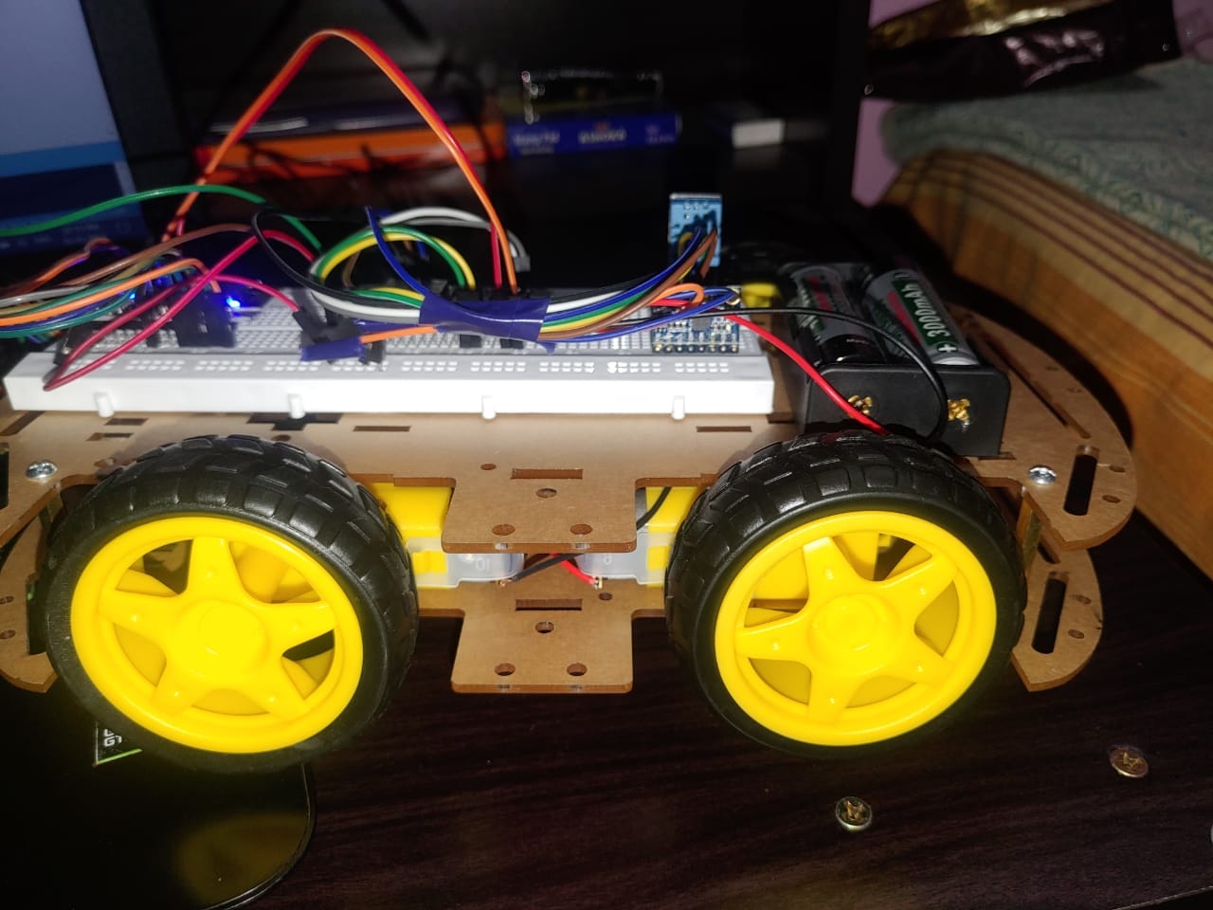

Slide 36
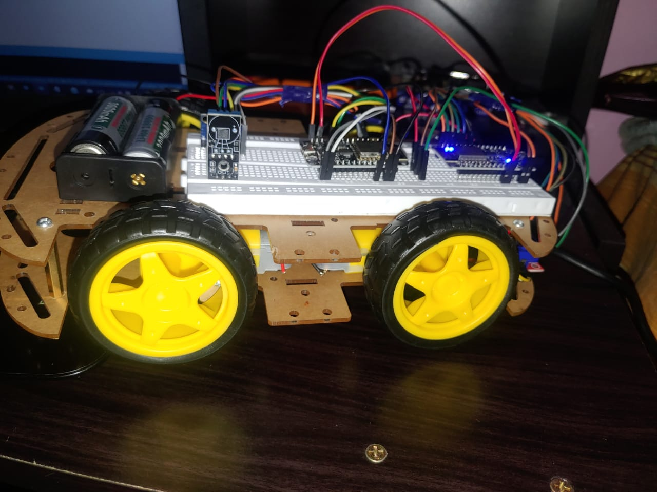

Slide 37
Reference
DTDL: https://github.com/Azure/opendigitaltwins-dtdl/blob/master/DTDL/v2/dtdlv2.md

Slide 38


